Slide 1
CONSUMER FINANCE MANAGEMENT SYSTEM
Presented by
Soumalya Kundu
Ganesh Patnala
Mounika Meka
Rakshit Joshi
Malhar Marathe

Slide 2
TABLE OF CONTENTS:
PROBLEM STATEMENT
TYPES OF USERS
FUNCTIONALITIES PROVIDED TO USER
APPROACH/ DESIGN IMPLEMENTATION
TECHSTACK
UI PAGES
DATABASE SCHEMA
REST APIS

Slide 3
PROBLEM STATEMENT:
This Project belongs to Finance domain. In general, when user wants to purchase products using EMI feature of online shopping, user must have a credit card. While payment of EMI every month, user has to pay some interest with EMI which varies for credit cards of different banks. "Finance Management System" is a web application in which the concept of no cost EMI is introduced where user doesn't have to pay any interest on EMI and it is not mandatory for user to have credit card in order to purchase product via EMI since an EMI card will be given to users after Registration on this system if the user meets the eligibility criteria. If all the documents provided by the user are approved, then EMI card gets activated for which user has to pay the joining fee for the card user chooses. Using that EMI card, users will be able to purchase different products according to their card limit. The product which user will purchase, some processing fee will be taken from the user which will be an earning resource for the company. The users will be able to view their purchased products in Dashboard and how much amount they are supposed to pay in upcoming months.

Slide 4
TYPES OF USERS:
User – The one who has the access to the products and purchases the products
Admin – The one who will be able to access the details of every user registered
This Project is developed to manage the user activities.
FUNCTIONALITIES PROVIDED TO USER:
Registration
Login
Purchasing Products
Transaction History
Logout

Slide 5
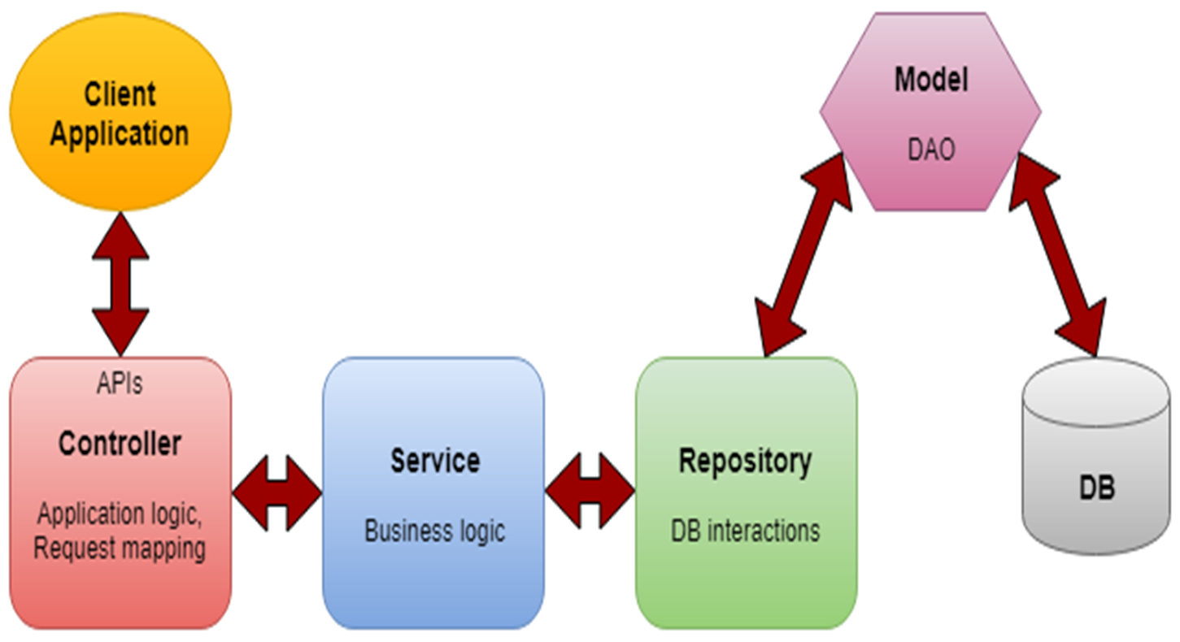
APPROACH:

Slide 6
TECH STACK:
UI LAYER:
CSS3
REACT JS
MIDDLEWARE RESTFUL API:
SPRING BOOT REST API WITH MVC
DATABASE & DATABASE PERSISTENCE:
MYSQL
JPA

Slide 7
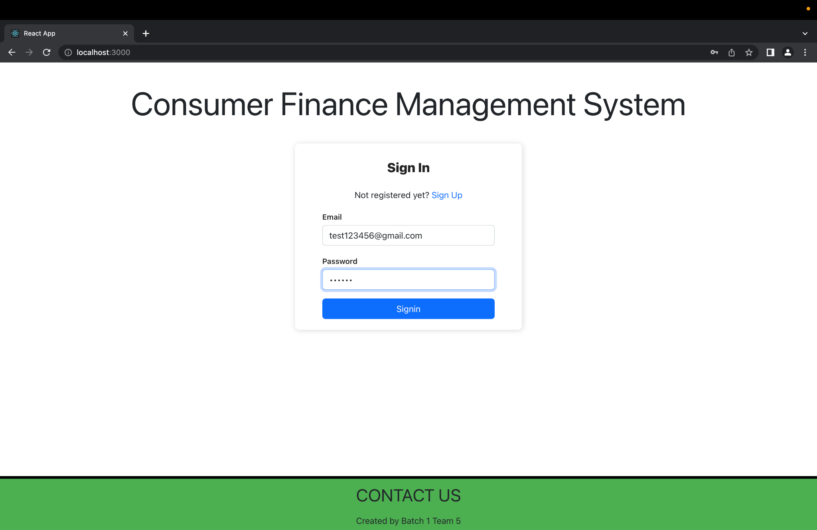
LOGIN:

Slide 8
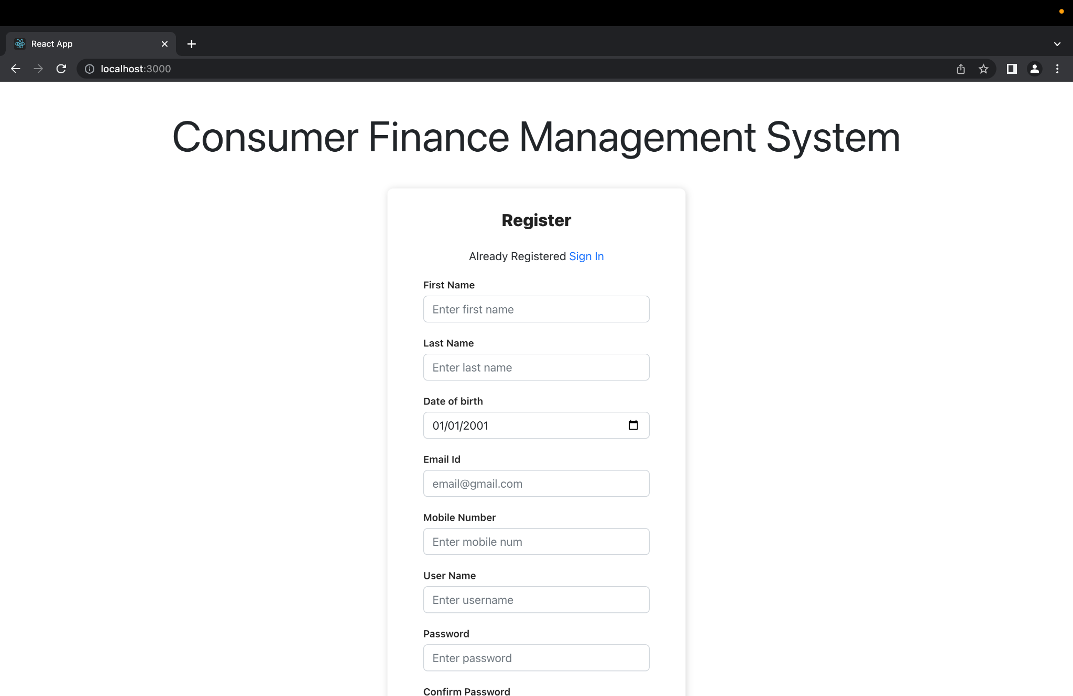
REGISTRATION:

Slide 9
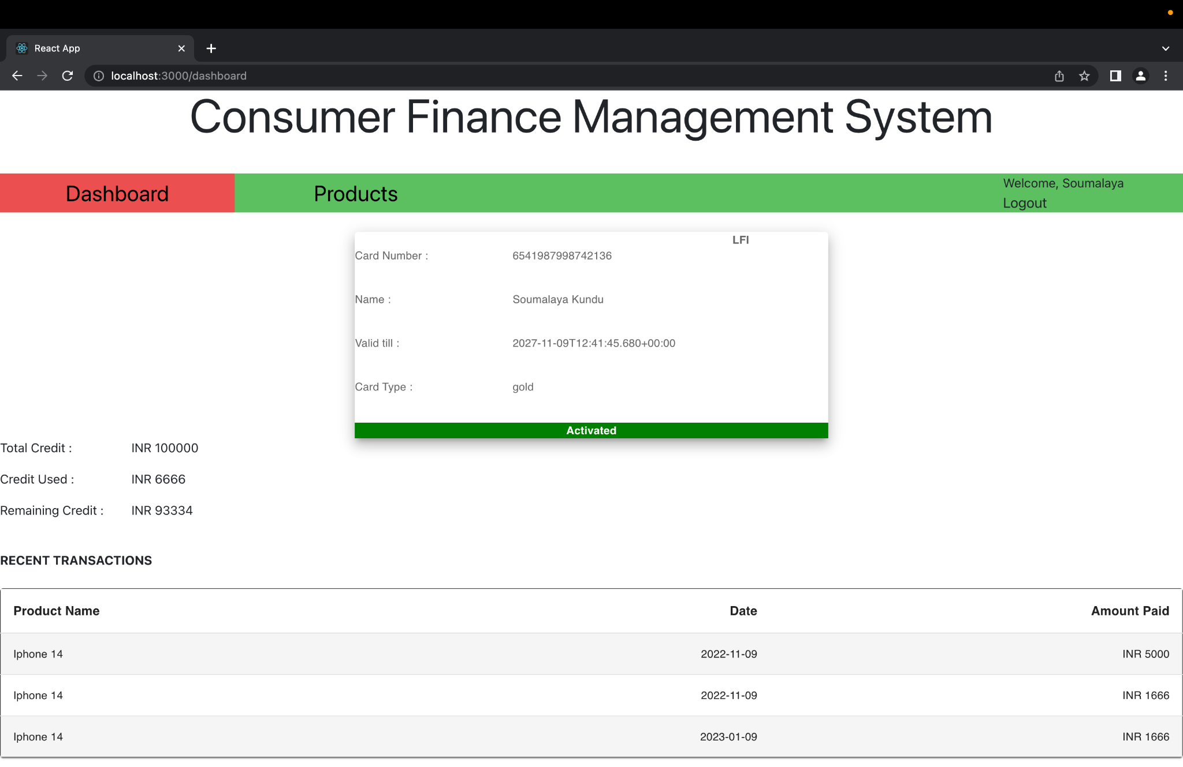
DASHBOARD:

Slide 10
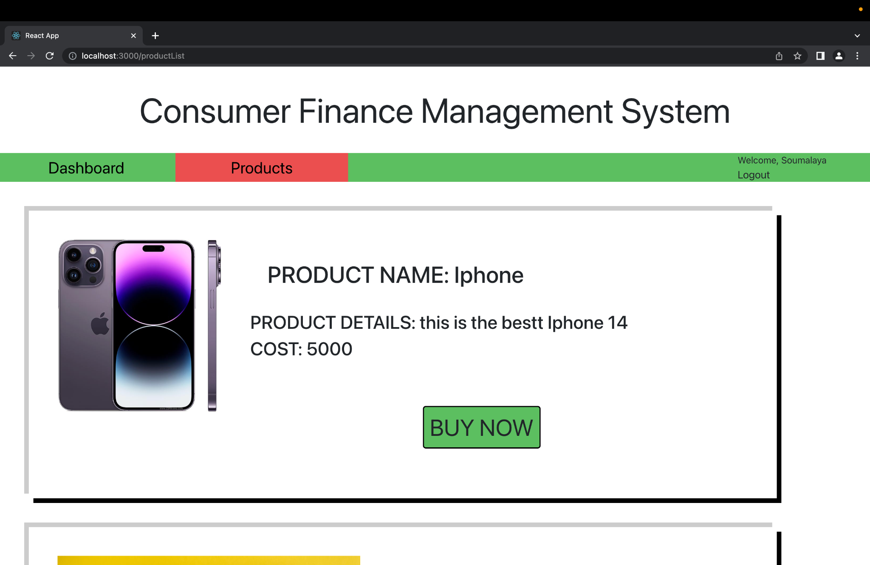
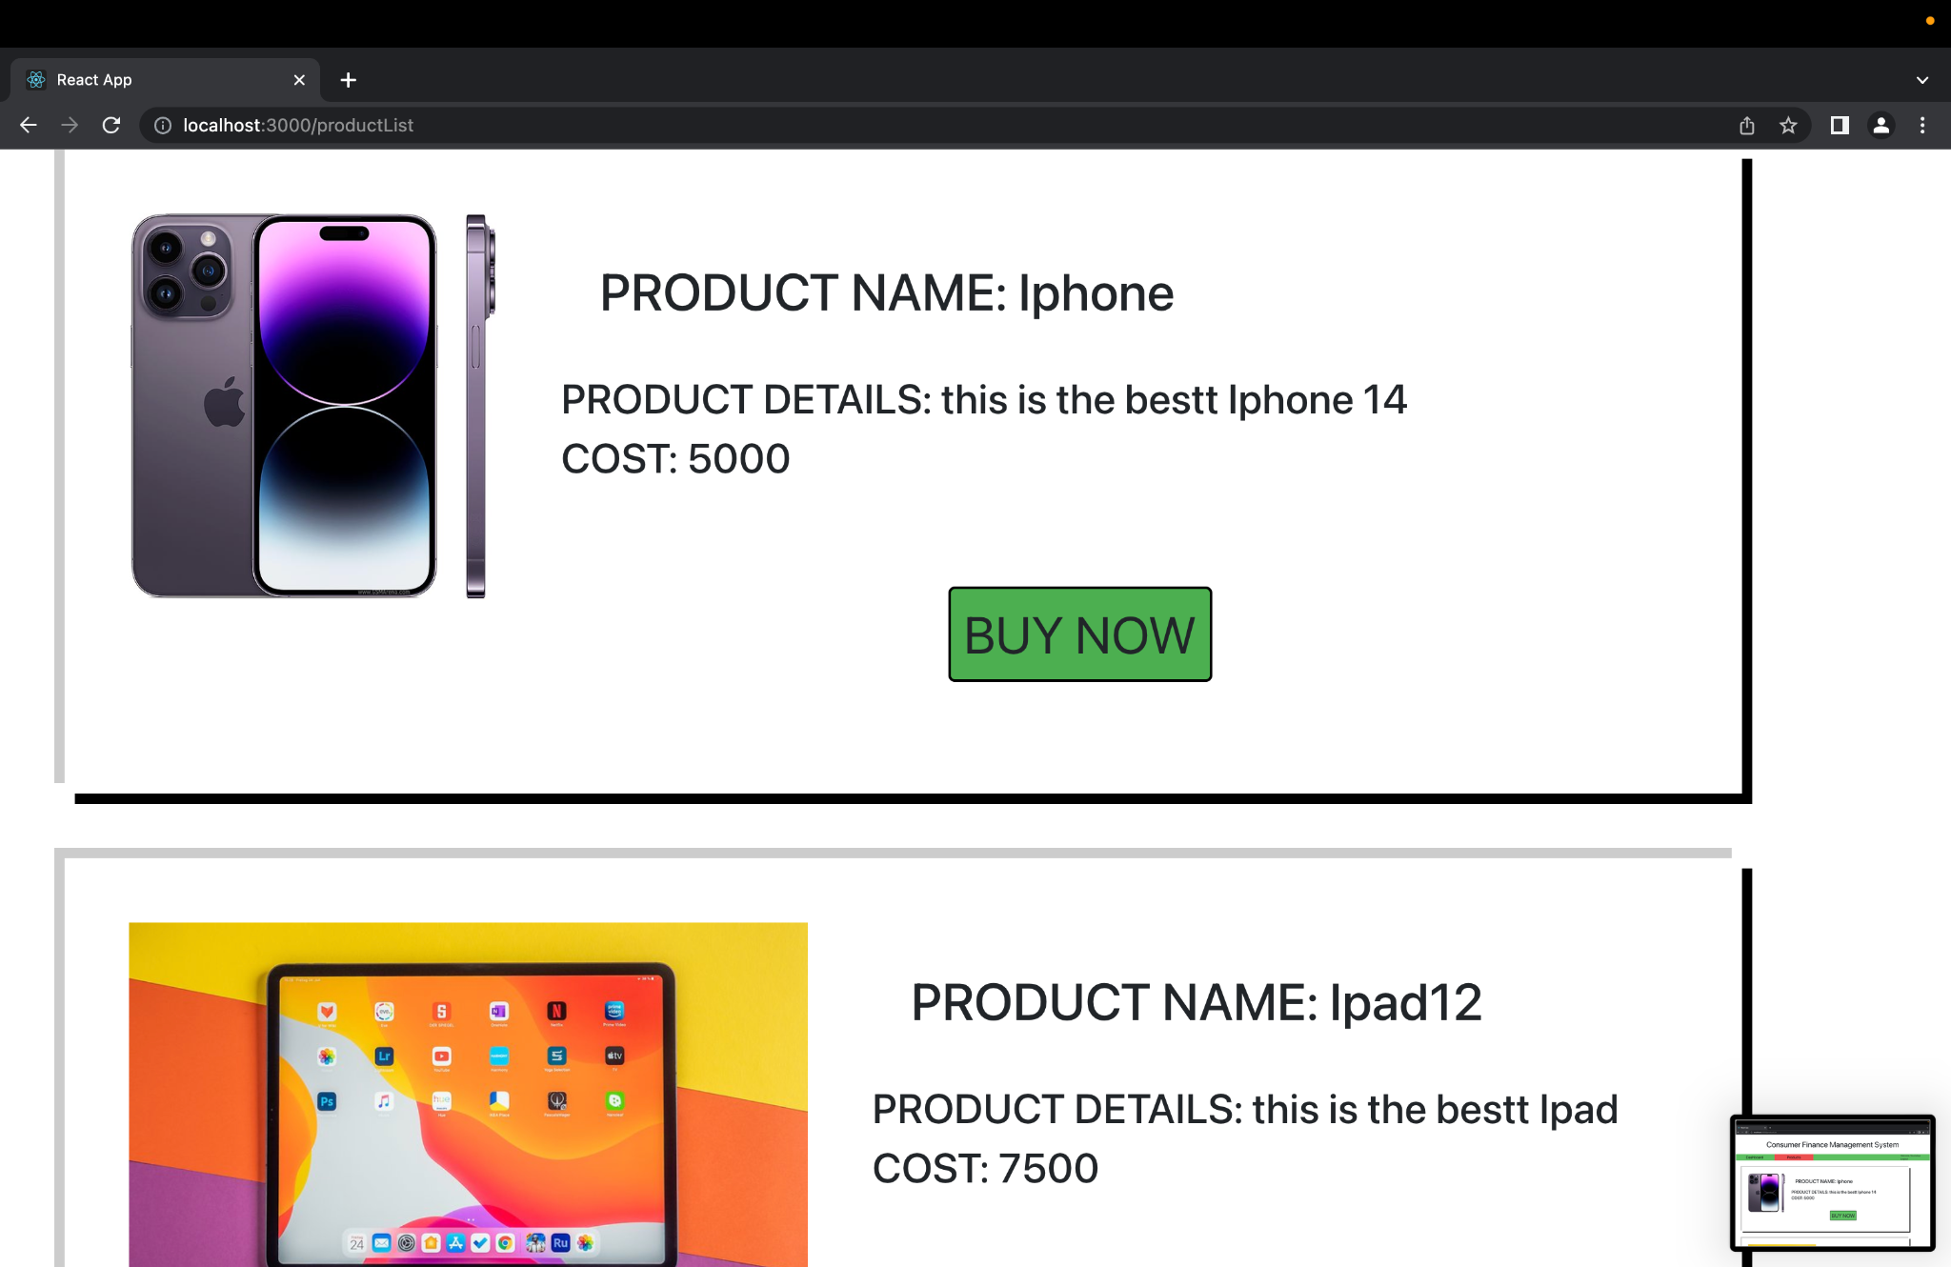
PRODUCT LIST:

Slide 11
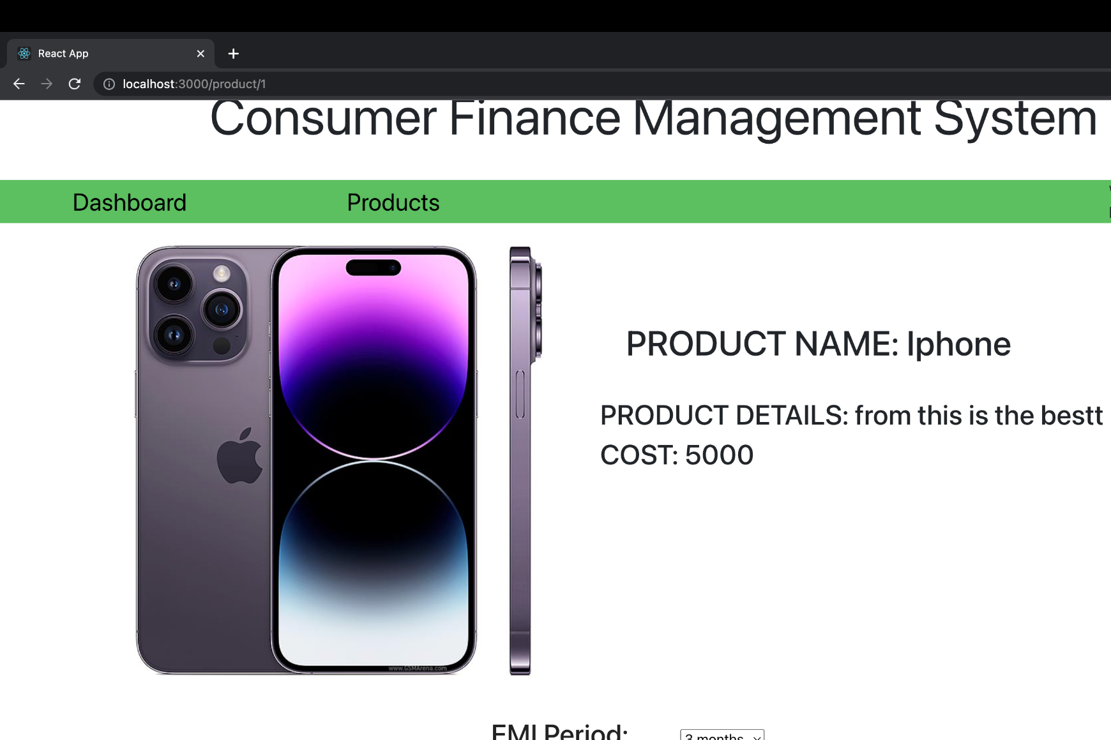
PRODUCT INFO:

Slide 12
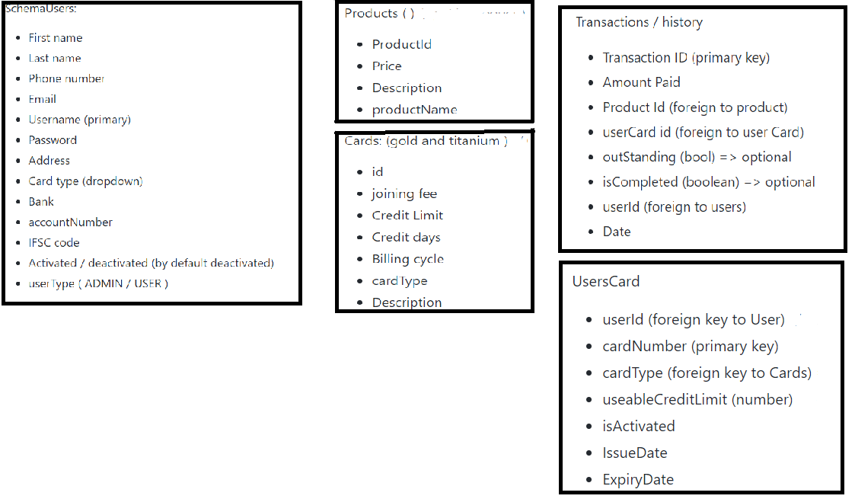
DATABASE SCHEMA:
User

Slide 13
REST API:
http://localhost:8082/cfms/api/login
http://localhost:8082/cfms/api/register
http://localhost:8082/cfms/api/getProduct
http://localhost:8082/cfms/api/getAllProducts
http://localhost:8082/cfms/api/getCardDetails
http://localhost:8082/cfms/api/getAllTransactions
http://localhost:8082/cfms/api/purchase
http://localhost:8082/cfms/api/getTransactions
http://localhost:8082/cfms/api/getTransactionById

Slide 14
THANK YOU

